Slide 1
Two-Part Tariffs
Module 6 · Video 7
Management 405
Prof. Nico Voigtländer · UCLA Anderson

Slide 2
Module 6 · Video 7 · Agenda
Outline of Module 6
1
Simple vs. Complex Pricing
Video 2
2
Direct Price Discrimination
Videos 3+4
2a
Perfect Price Discrimination (First Degree)
Video 3
2b
Segment Pricing (Third Degree)
Video 4
3
Indirect Price Discrimination (Second Degree)
Video 5
4
Advanced Pricing Strategies
Videos 6–8
4a
Flat Fee Pricing
Video 6
4b
Two-Part Tariff
A flat fee plus a usage fee set at marginal cost
Video 7
4c
Block Pricing
Video 8
5
Summary of Pricing Strategies
Video 9
Management 405 · Module 6 · Complex Pricing and Advanced Pricing Strategies
2
Notes:
Now the case where serving an extra unit actually costs something.

Slide 3
Module 6 · Video 7 · Two-Part Tariff
Two-Part Tariff (Now MC > 0)
P
Flat fee F* = the entire consumer surplus
Usage fee P* = marginal cost
F*
Revenue from usage fee
MC
P*
Revenues from usage fee
D
Q_{usage}
Q
Management 405 · Module 6 · Complex Pricing and Advanced Pricing Strategies
3
Notes:
Once marginal cost is positive, the pure flat fee breaks down, because the customer consumes until the value of the last unit is zero and you pay for all of it. The fix is two prices. Set the usage fee at marginal cost, which makes the customer stop at the right quantity, and then take the whole remaining consumer surplus as the flat fee.

Slide 4
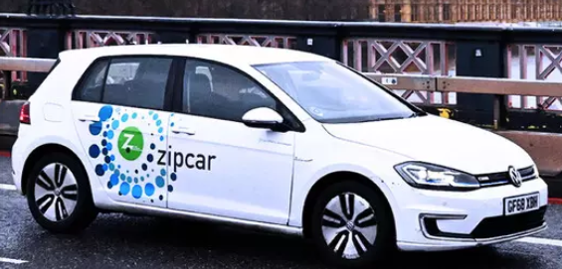
Module 6 · Video 7 · Two-Part Tariff
Two-Part Tariff: Summary
Pricing decision is setting the flat fee (F) and the per-unit usage fee (P)
  Zipcar: annual membership (fixed fee), hourly rental fee (per-unit price)
  Amazon Prime: yearly charge (fixed fee), any purchase (per-unit price)
Set the usage fee P* = MC
  Avoids excessive use
Set the flat fee F* = entire consumer surplus
Management 405 · Module 6 · Complex Pricing and Advanced Pricing Strategies
4
Notes:
So the two-part tariff is one decision made twice. The usage fee is set by efficiency: put it at marginal cost and the customer self-regulates. The flat fee is set by extraction: take the triangle that is left. Video game consoles and their games, Zipcar's membership and its hourly rate, Amazon Prime and the purchases, are all this structure.

Slide 5

Module 6 · Video 7 · Two-Part Tariff
Two-Part Tariff: Car Sharing
P
$$P = 1.5 − 0.01Q$$
Two-part tariff:
$1.50
Flat fee F = $50
Usage fee P = $0.50 / mile
Revenue from usage fee = $50
Flat fee = $50
Would a flat fee with no usage fee (P = 0) be a good idea?
MC
$0.50
⇒
No — it would lead to excessive use
Revenues from Usage Fee = $50
D
100
Q (miles per year)
Management 405 · Module 6 · Complex Pricing and Advanced Pricing Strategies
5
Notes:
Here it is with numbers. Demand is P equals 1.50 minus 0.01Q and marginal cost is fifty cents a mile, so the member drives a hundred miles. Charge fifty cents a mile and the flat fee can be fifty dollars, which is the triangle above marginal cost. Ask the class the question on the right before you answer it: a flat fee with no usage charge would have members driving far past the point where the miles are worth anything.

Slide 6


Module 6 · Video 7 · Two-Part Tariff
Pricing at a Local Zoo
Demand for the average customer is:
$$P = 40 − 8Q$$
Q: visits per year
Marginal cost per visit: MC = $8
What is the optimal pricing strategy?
✎ Problem Set 5
Poll Break
Management 405 · Module 6 · Complex Pricing and Advanced Pricing Strategies
6
Notes:
Here is the exercise. Demand for the average customer is P equals 40 minus 8Q, where Q is visits per year, and each visit costs the zoo eight dollars. Give them a minute on the poll before working it through.

Slide 7
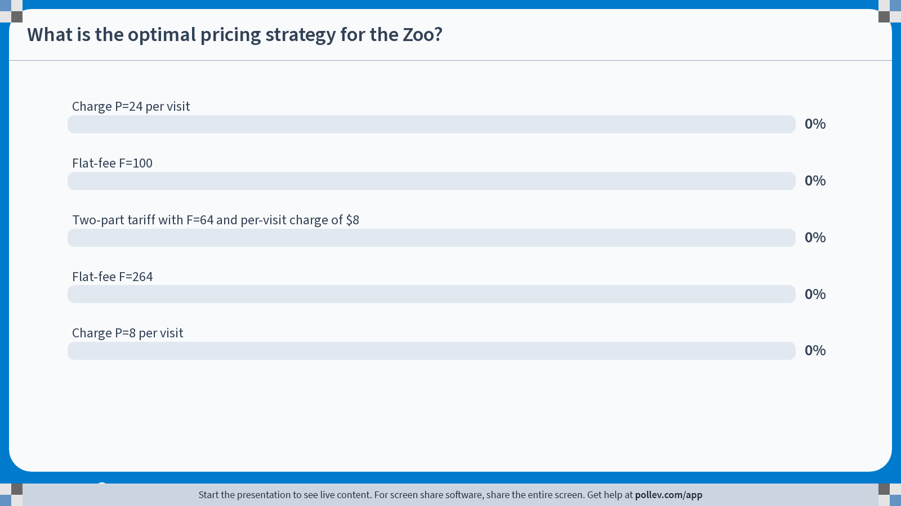
Notes:
Poll Title: Do not modify the notes in this section to avoid tampering with the Poll Everywhere activity.
More info at polleverywhere.com/support
What is the optimal pricing strategy for the Zoo?
https://www.polleverywhere.com/multiple_choice_polls/hmpajEICOBWnni2rKMoIs?state=opened&flow=Default&onscreen=persist

Slide 8
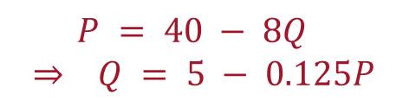
Module 6 · Video 7 · Two-Part Tariff
Zoo Pricing – Solution
P
$$P = 40 − 8Q$$
$$⇒ Q = 5 − 0.125P$$
$40
Two-part tariff:
Flat fee F = $64
Usage fee P = $8/visit
Revenue from usage fee = $32
Revenues from usage fee recover the variable costs of $32
Flat fee
= $(40 − 8)·4/2 = $64
Profit: $64 per customer (before any fixed cost)
MC
$8
Revenues from usage fee = $8·4 = $32
D
4
5
Q (visits per year)
Management 405 · Module 6 · Complex Pricing and Advanced Pricing Strategies
8
Notes:
The answer. Set the per-visit charge at marginal cost, eight dollars, and the customer comes four times. The surplus left above that line is thirty-two times four over two, which is sixty-four dollars, and that is the membership. The per-visit charge brings in thirty-two dollars, exactly the variable cost of the four visits, so the zoo keeps the sixty-four.

Slide 9
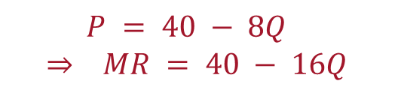

Module 6 · Video 7 · Two-Part Tariff
Zoo Pricing – Comparison to Simple Pricing
P
$$P = 40 − 8Q$$
$$⇒ MR = 40 − 16Q$$
$40
Simple Pricing:
$$MR = MC = 8 ⇒ Q^{∗} = 2; P^{∗} = 24$$
$24
Simple pricing profits:
$32
Profit: $32 per customer (before any fixed cost)
MC
$8
D
MR
2
5
Q (visits per year)
Management 405 · Module 6 · Complex Pricing and Advanced Pricing Strategies
9
Notes:
Compare it with one simple price. Marginal revenue is 40 minus 16Q, and setting that equal to the eight dollar marginal cost gives two visits at twenty-four dollars, so thirty-two dollars per customer. The two-part tariff doubled that, and it did so by serving the customer more, not less.

Slide 10

Module 6 · Video 7 · Two-Part Tariff
Zoo Pricing – Comparison to Flat Fee
P
$40
$$P = 40 − 8Q$$
Flat-Fee Pricing:
Flat fee F = $100
Costs due to visits: $40
Overall 5 visits, since the price paid per visit is now zero
Excess variable cost not covered by the flat fee
Flat fee
= $40·5/2 = $100
Profit: $60 per customer (before any fixed cost)
D
MC
$8
Variable cost = $8·5 = $40
Two-part tariff: $64 > pure flat fee: $60
5
Q (visits per year)
Management 405 · Module 6 · Complex Pricing and Advanced Pricing Strategies
10
Notes:
And compare it with a pure flat fee. Charge a hundred dollars for unlimited entry and the customer comes all five times, because each visit is now free to her. Those five visits cost the zoo forty dollars, so it keeps sixty. The last visit is the problem: she values it at nothing and it still costs eight dollars to serve. The usage fee in the two-part tariff is what stops that over-use, and it is worth four dollars here.

